Slide 1
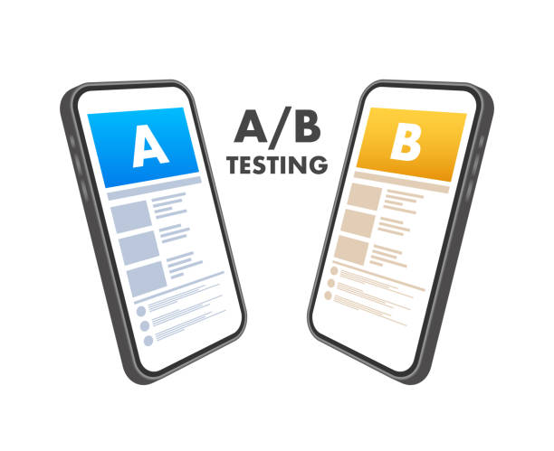
A/B Testing of Online Advertising
A/B Testing of Online Advertising
Which is Better ?

Slide 2
Agenda
Problem Statement
Visualizations and Analysis
Recommendation and Insights

Slide 3
Problem Statement
The goal of this project is to analyze and compare the performance of two different product advertisements (Product A and Product B) The objective is to determine which product's advert leads to a higher click-through rate (CTR) and estimate the probability that one product performs better than the other.

Slide 4
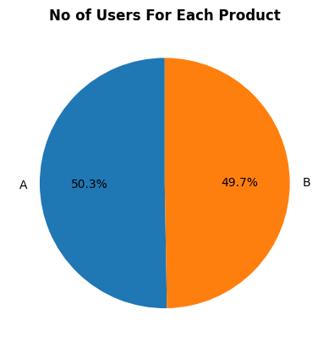
Users By Product
Product A has 50.3% users and Product B has 49.7% users . No of Users are close for both But maybe Product A is More engaging.

Slide 5
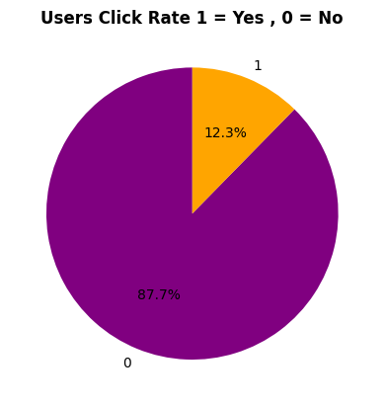
Users By Click Rate
No of Users that clicked are 12.3% and Non-click users are 87.7% . Need to Identify Why users are not Clicking Need to Focus on Content

Slide 6
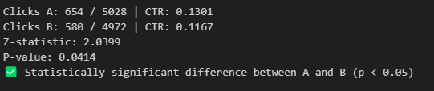
Hypothesis Testing
Performed Z-Test to Identify the Effectiveness of product . Product A is Better as Compared to Product B

Slide 7

Bayesian A/B Testing
Performed Bayesian Testing to Determine the Probability of Product A Effectiveness which is 97% more Accurate as compared to Product B

Slide 8
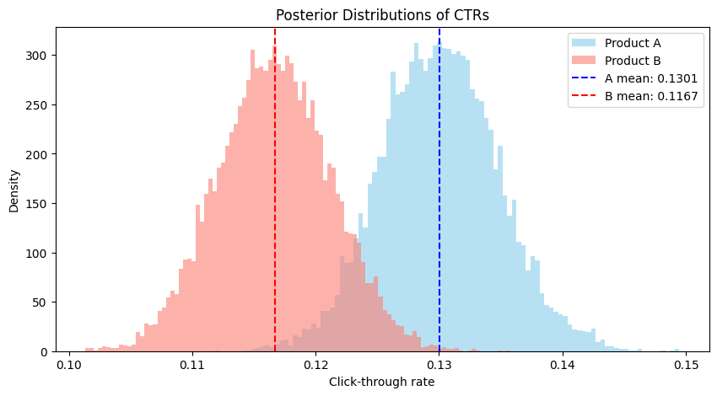
Conclusion
Product A is Better the Company should move with Product A . Also company should focus on marketing to increase the click rate .

